Slide 1
Inspire Finance Students of Machine Learning
-The visual way
Cinder (Xinde) Zhang
University of Arkansas
FMA 2022 Atlanta

Slide 2
The Demand
CNBC 2019
“Finance jobs requiring A.I. skills increased 60% last year”
CFI list Machine Learning as one of the top 6 Skills in Finance

Slide 3

The Challenge
Finance Students
Little or no coding experience
Uncomfortable with data and modeling
And more…
Educators
Lack of effective and intuitive tool for teaching the subject

Slide 4
Visual Approach
Process
Define a meaningful business research question
Research data availability
Design the process
Data collection/processing
Feature generation
Build machine learning model(s)
Model testing
Refine the model and/or question
The Tool
Dataiku
Assemble the process visually
With the steps as visual blocks

Slide 5
Example
The Question: Can we identify factors which may predict Bitcoin (BTC) daily return?
First guess
Active address of BTC?
Data and resources
https://github.com/CinderZhang/FinML/blob/main/ML%20Resource.ipynb
Metric Catalog - Glassnode Studio - On-Chain Market Intelligence

Slide 6
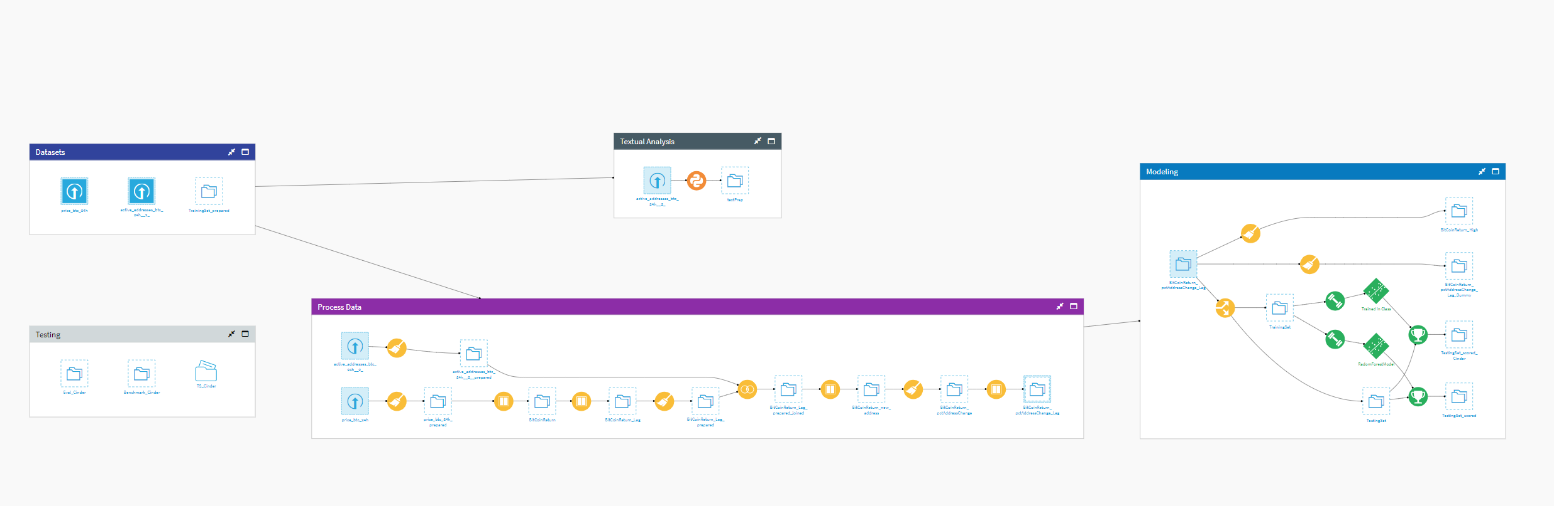
Overview
Notes:
https://arkansas-universitygrads22.academics.dataiku-dss.io/
xzhang
CH8DZ4DY6aZUvW828J6E

Slide 7
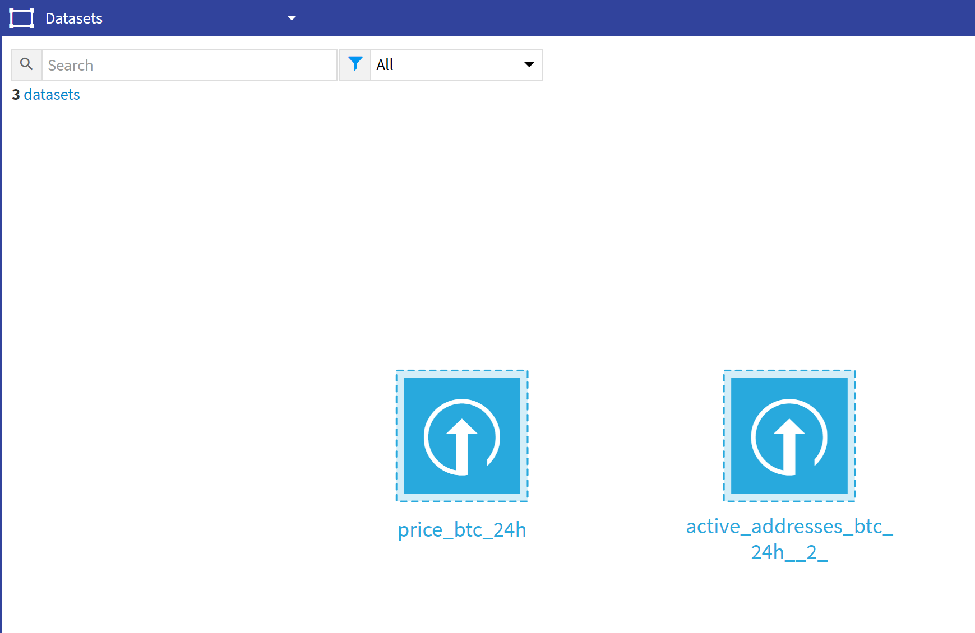
Building Blocks
1: Datasets

Slide 8
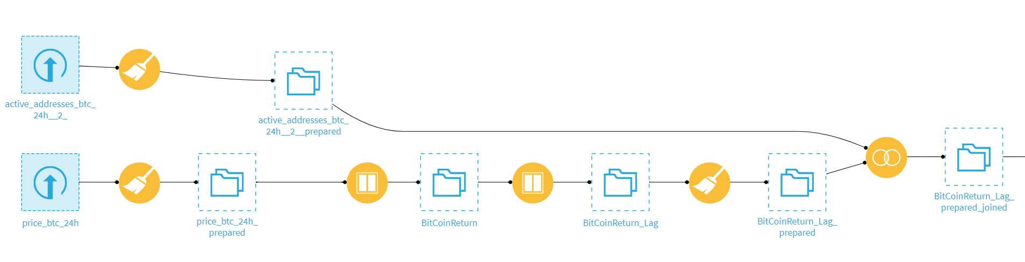
Building Block 2
2: Data Processing

Slide 9
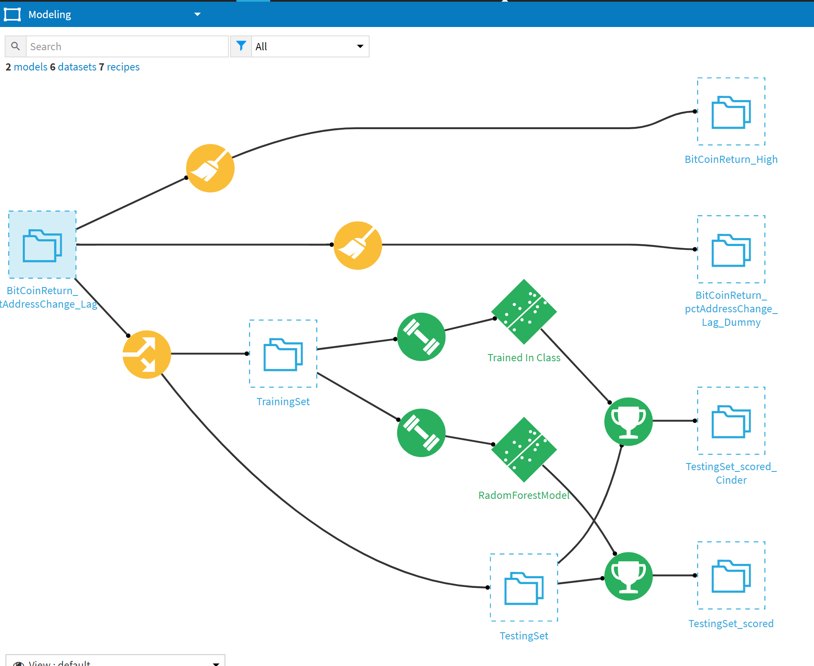
Building Block 3
3: Modeling and Testing

Slide 10
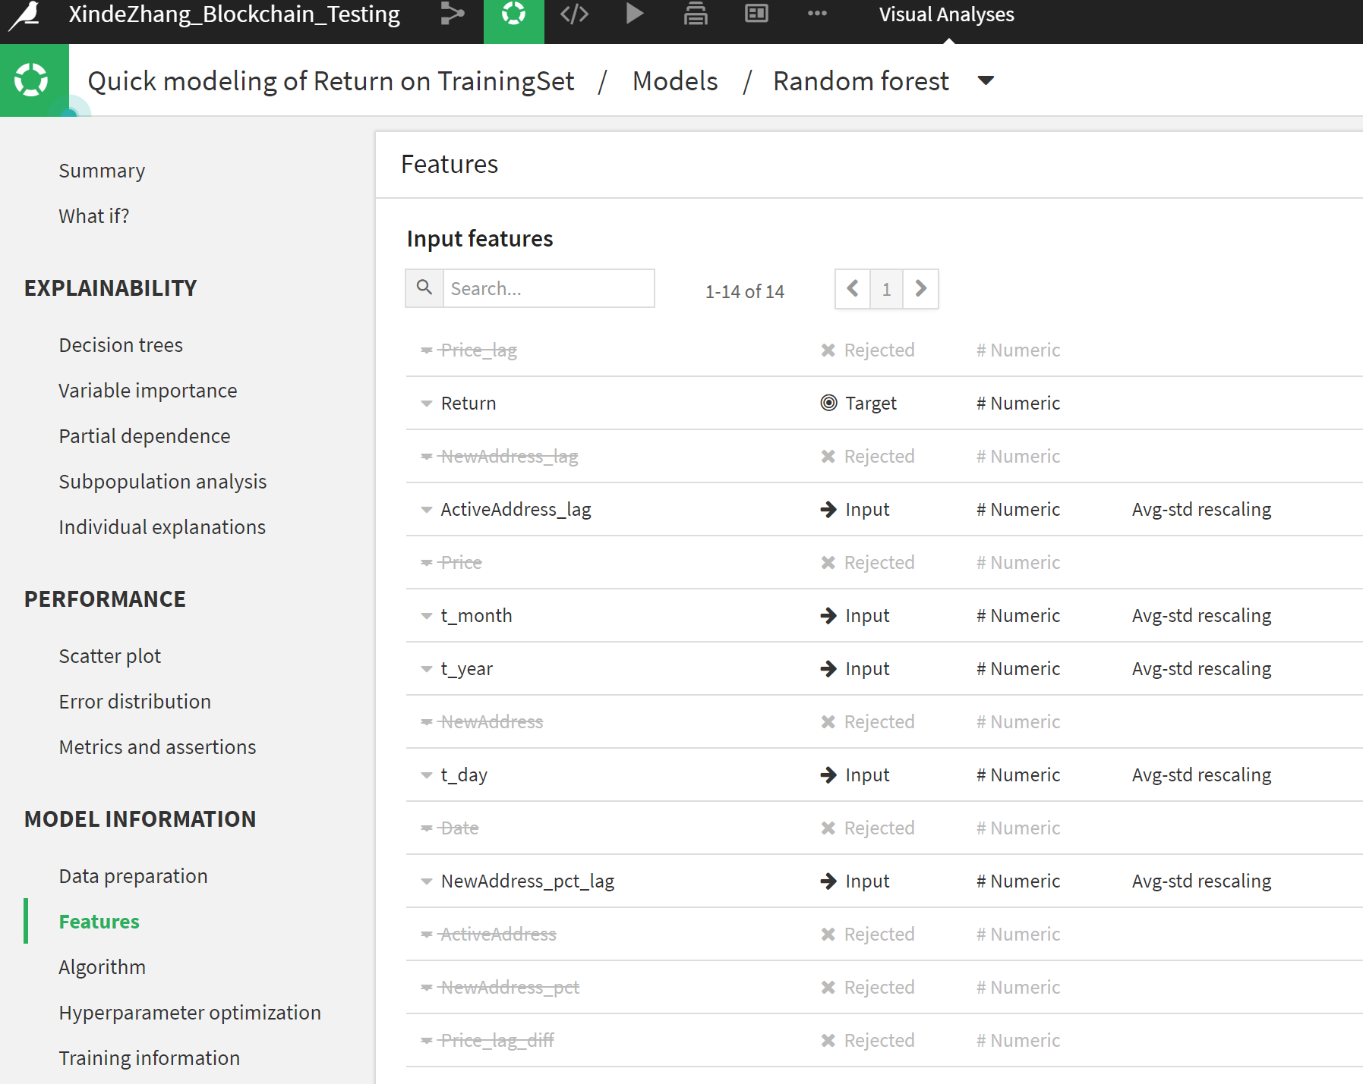
Close Look of the Model(s)

Slide 11
Future Work for Students
More data
More possible factors
Refine the Question

Slide 12

Ah!

Slide 13

Thank you
This Photo by Unknown Author is licensed under CC BY

